Slide 1

Green Production of Terephthalic Acid for the Synthesis of PETE
Team 3: Timothy Chen, Qingyuan Liu, Tom Sikorski, Yiqi Wang
May 12, 2016

Slide 2
Outline
PETE Production
Green Routes
Isobutanol to P-xylene Process
CHEMCAD Simulation
Economic Analysis
Environmental, Health, and Safety Concerns
Sustainability and Concluding Remarks

Slide 3
Polyethylene Terephthalate (PETE)
One of the most common types of polymers
Global PETE production in 2015 was estimated to reach 24.39 million tons†
Lightweight, impact resistance, and chemical resistance make it ideal for food packaging, plastic bottles, and textiles
† Merchant Research & Consulting, Ltd. http://mcgroup.co.uk/news/20140117/global-pet-supply-exceed-2439-mln-tonnes-2015.html

Slide 4
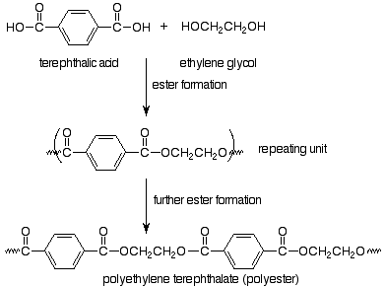
PETE Production
Typically produced with terephthalic acid (TPA) and ethylene glycol (EG)
Undergo condensation reactions in esterification vessels forming BHET
Followed by polymerization in reactors to form PETE
†U.S. Environmental Protection Agency, “Compilation of Air Pollutant Emission Factors,” Publication AP-42, https://www3.epa.gov/ttnchie1/ap42/ch06/final/c06s06-2.pdf, EPA, Office of Air Quality Planning and Standards, Research Triangle Park, NC (Jan. 1995).
Notes:
bio-hydroxyethyl terephthalate (BHET)

Slide 5
Green Routes Overview
Sugar Cane
Ethanol
Ethylene
PX
Enzyme
Sugar
HMF
DMF
BIOMASS
TPA
Fermentation
Isobutanol
Isobutylene
isoprene and acrylic acid
4-methylcyclohex-3-enecarboxylic acid
Fermentation
Limonene
P-cymene
Furfural
Maleic anhydride
†Based on figure from Pang et.al. Synthesis of ethylene glycol and terephthalic from biomass for producing PET. Green Chem. 2016,18, 342.

Slide 6
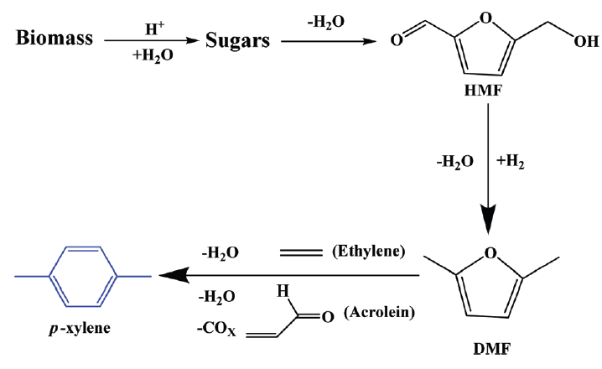
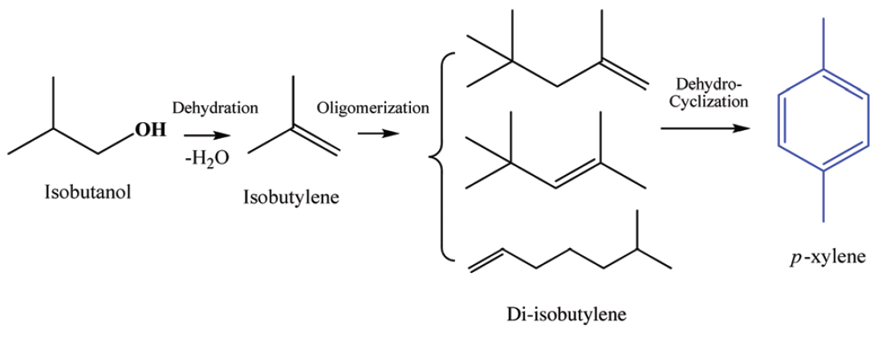
Green Routes: Isobutanol and HMF Routes
HMF pathway (CCEI) †
Isobutanol pathway (GEVO)†
Estimated p-xylene cost of $3,962/mt††
Large capital cost from expensive Cu-Ru/C catalyst
Catalyst replacement is also majority of operating cost
Large solvent usage (THF, n-heptane)
Estimated p-xylene cost of $3,481/mt††
Majority of operating cost from raw material (starch) price(46%)
Valuable side products (o-xylene, benzene,etc)
Petroleum based p-xylene is at $1630/mt
†Reaction pathways taken from Pang et.al. Synthesis of ethylene glycol and terephthalic from biomass for producing PET. Green Chem. 2016,18, 342.
†† Z. Lin; V. Nikolakis; M. Ieraptetritou, Ind. Eng. Chem. Res., 2014, 53, 10688-10699.

Slide 7
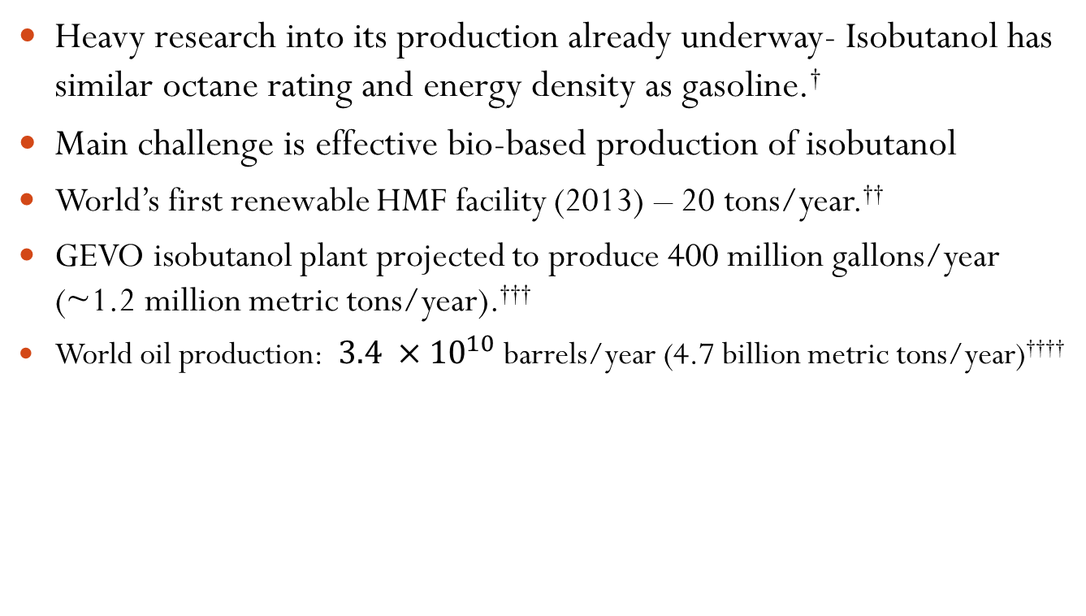
Isobutanol and HMF Routes: Promise of Isobutanol
Heavy research into its production already underway- Isobutanol has similar octane rating and energy density as gasoline.†
Main challenge is effective bio-based production of isobutanol
World’s first renewable HMF facility (2013) – 20 tons/year.††
GEVO isobutanol plant projected to produce 400 million gallons/year (~1.2 million metric tons/year).†††
World oil production: $3.4 ×{10}^{10}$ barrels/year (4.7 billion metric tons/year)††††
† Advanced Motor Fuels. http://www.iea-amf.org/content/fuel_information/butanol/properties
†† First Industrial Production For Renewable 5-HMF
https://chemicalparks.eu/news/2014-2-3-first-industrial-production-for-renewable-5-hmf
††† Second-Generation Biofuel: Isobutanol Producing Biocatalyst
https://www.epa.gov/sites/production/files/2015-06/documents/gevo010711.pdf
†††† International Energy Statistics 2014 https://www.eia.gov/cfapps/ipdbproject/IEDIndex3.cfm?tid=5&pid=53&aid=1

Slide 8
Isobutanol to P-xylene Process
Feed rate of 150 million kg/year (17123 kg/hr) of isobutanol
Chosen to be on same order of magnitude as 5% of current NA PETE production
Use 30% mole fraction isobutanol
26839 kg/hr flow rate of isobutanol-water mixture
Shell and tube heat exchangers with floating tube sheet heads
Most equipment made from carbon steel
Copper or titanium used when hydrogen present
Stainless steel for fired heater
Pressure drop in system dealt with by oversizing pumps
System insensitive in general to local pressure increases
Over pressurize system to account for pressure drop
Produces 99.5 % and 99.7 % purity p-xylene

Slide 9
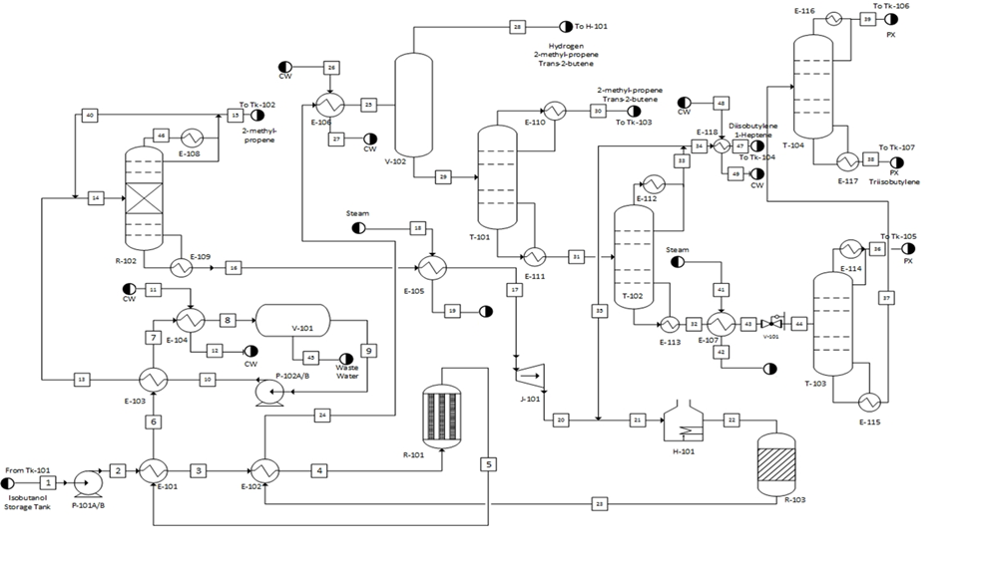
PFD Overview

Slide 10
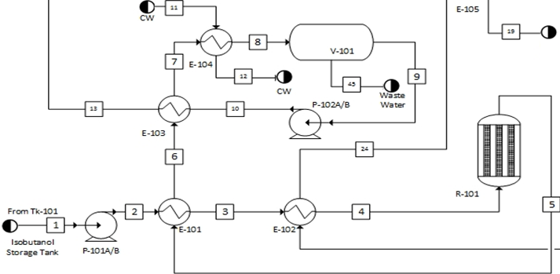
PFD Part 1 - Dehydration
Fully condense process stream (30 °C)
Decanter
Raise pressure to 15 bar
Product heat exchangers
Raise pressure to 10 bar
Dehydration reactor (325 °C) for production of isobutene

Slide 11
PFD Part 2 – Oligomerization and Dehydrocyclization

Slide 12
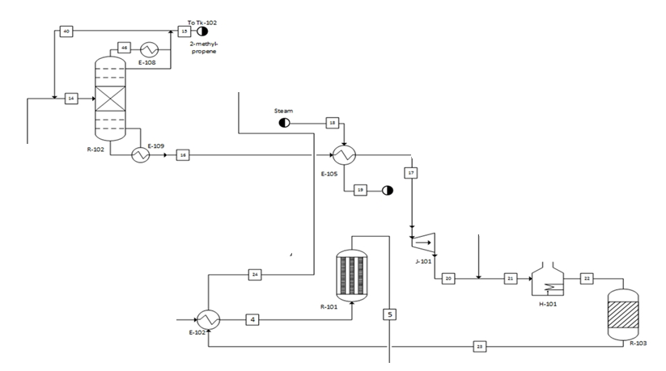
PFD Part 2 – Oligomerization and Dehydrocyclization
Vaporize stream to use in gas turbine
Isobutene
Heat stream to 500 °C for dehydrocylization reactor
Oligomerization Reactive Distillation to form DIB
Product heat exchanger
Dehydrocyclization reactor for formation of PX

Slide 13
PFD Part 3 – Separations

Slide 14
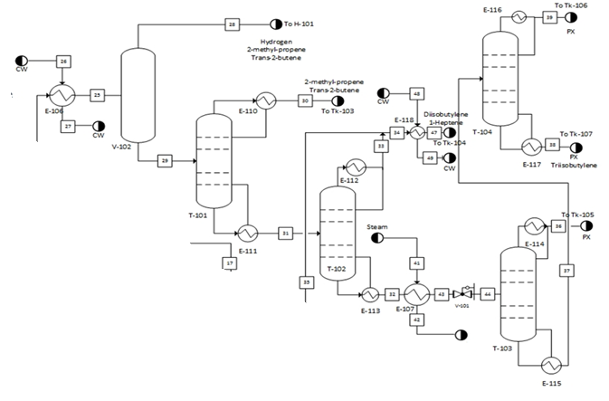
PFD Part 3 – Separations
Distillation to remove TIB from PX
PX and hydrocarbons
Flash off virtually all of methane and hydrogen
Distillation to remove C4
Distillation to remove DIB
Distillation to remove TIB from PX

Slide 15
Simulation Overview
Single simulation to detect process wide effects of changes
Pieces result in recycle streams not matching in terms of mass balances
Sections ran individually for convergence before including recycle streams, then combined until entire simulation converged
Multiple thermodynamic models used, local models applied where needed; selected based on Don’t Gamble with Physical Properties for Simulation†
†Carlson, E. Don’t Gamble with Physical Properties for Simulation. Chemical Engineering Progress. 1996.
Notes:
Best practice to confirm VLE data in simulation with experimental data, little to no resources on the VLE data for particular components (i.e. p-xylene and DIB VLE, p-xylene and TIB VLE, isobutene and DIB VLE, isobutene and p-xylene VLE, etc.).
Most of process run at 10 bar and was highly non-ideal, global UNIFAC/LATE model chosen.
Reactive distillation column run at 15 bar, and heuristics said PSRK outperform UNIFAC at higher pressures, so PSRK/LATE chosen as a local model
UNIFAC unable to accurately reproduce solubility of isobutene and water even with water/hydrocarbon selected as immiscible and they are known to be nearly insoluble in water so UNIFAC model was inappropriate for liquid-liquid separator. However, UNIFAC LLE is extension of UNIFAC and dedicated to modeling liquid liquid equilibrium. This model had water and isobutene phases correctly partitioning in separator and recommended model for liquid-liquid systems.
Rest of the simulation was run using the global thermodynamic model.

Slide 16
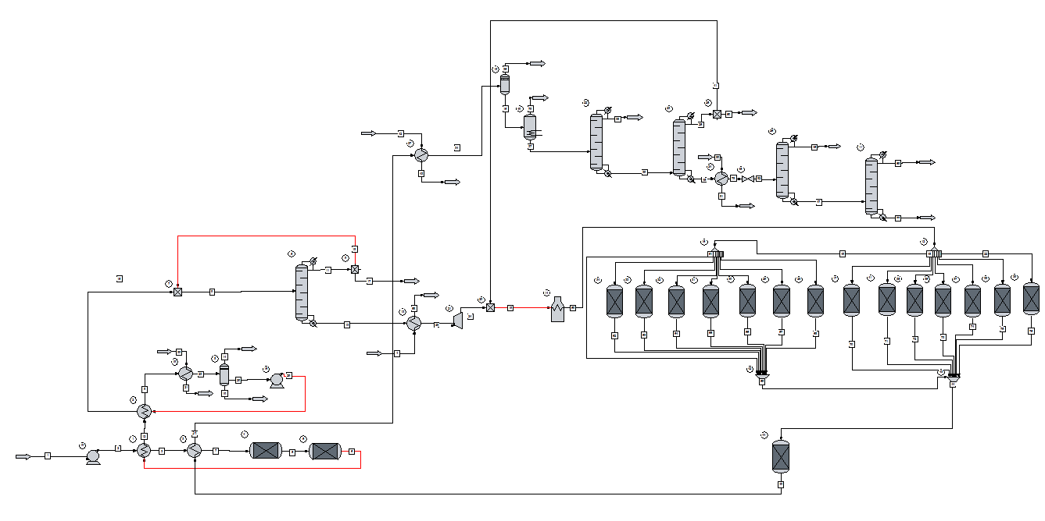
Simulation Overview

Slide 17
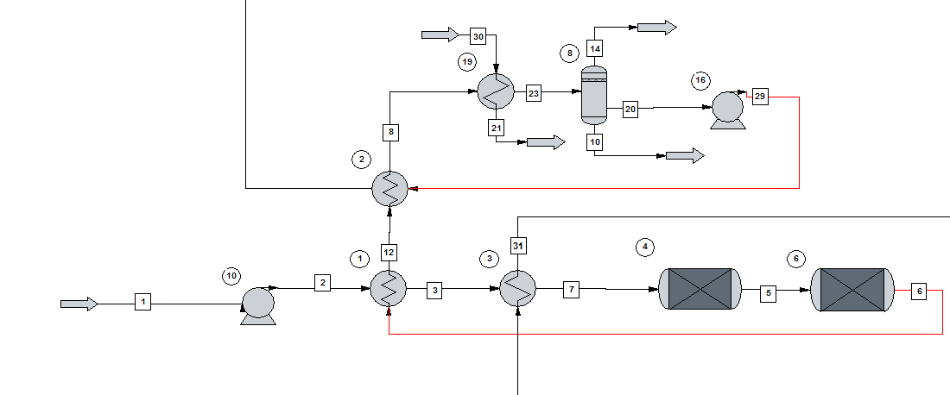
First Reaction

Slide 18
First Reaction
Done with two reactors as kinetics for butene side product could not be found
Paper studying kinetics of isobutanol dehydration†
Conversion of isobutanol was 99% & Selectivity was 95%
Our conversion was 97% with 95% selectivity
Major side products linear butenes, collectively represented by trans-2-butene
† Dehydration of isobutanol to isobutene in a slurry reactor (Technical Report) | SciTech Connect. http://www.osti.gov/scitech/biblio/171265

Slide 19
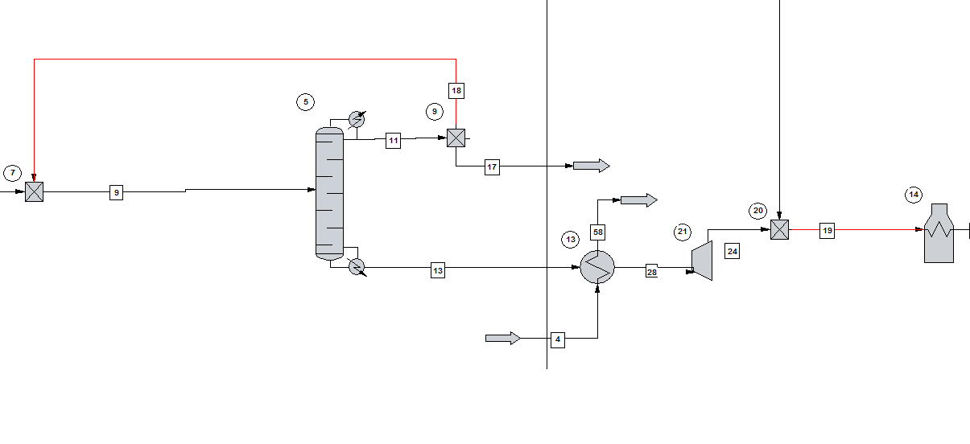
Second Reaction

Slide 20
Second Reaction
SCDS column with reactive distillation option used with di-isobutylenes collectively represented by 1-di-isobutylene
Reality, reactions involving formation of tert-butyl alcohol from water affecting rate of oligomerization and selectivity
IB + IB → DIB
DIB + IB → TIB
TIB + IB → TEB
IB + H₂O → TBA
TBA → IB + H₂O
Couldn’t converge for complex kinetic equations, only two reactions specified
Notes:
Formation of tetramers assumed negligible as described by paper studying this oligomerization reaction

Slide 21
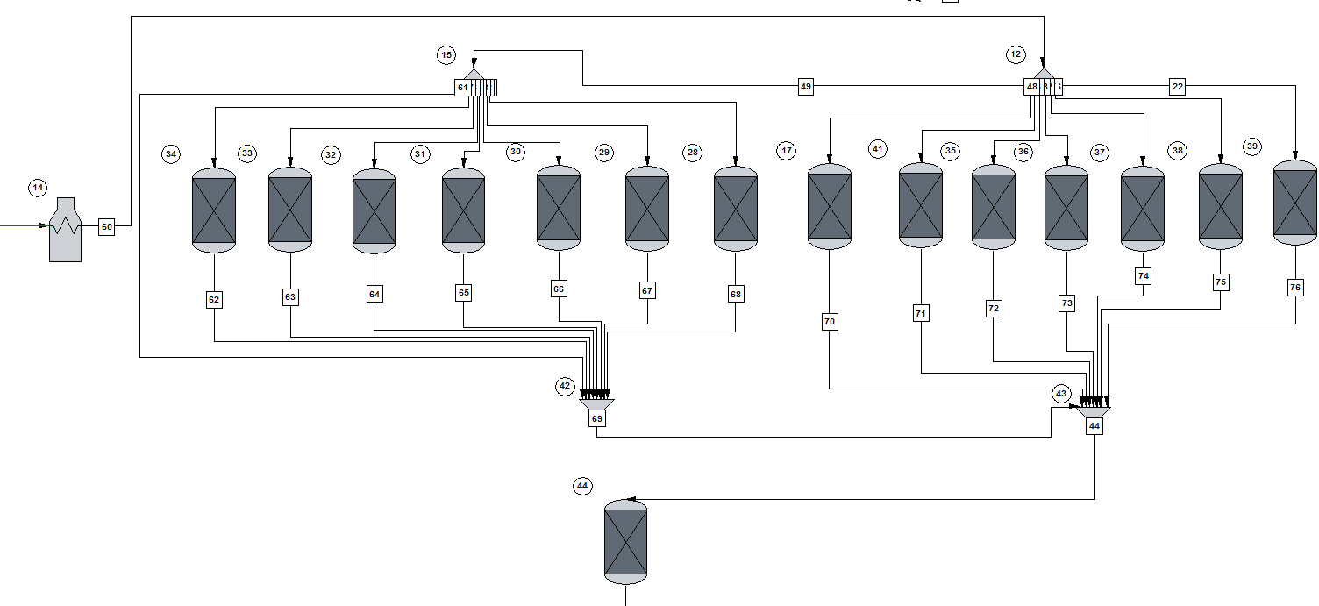
Third Reaction

Slide 22
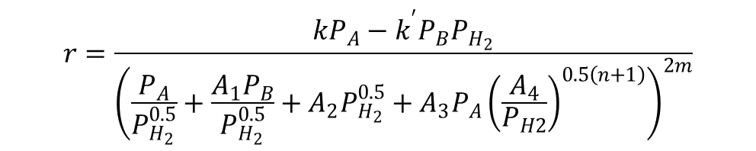
Third Reaction
Direct kinetics of dehydrocyclization for di-isobutylene (2,4,4-Trimethyl-1-Pentene) to p-xylene not available
Similar kinetics for 2,4,4-Trimethyl-Pentane
Rate expression simulated in kinetic reactor using user defined VBA expression
$$r=\frac{kP_{A}−k^{′}P_{B}P_{H_{2}}}{{\left(\frac{P_{A}}{P_{H_{2}}^{0.5}}+\frac{A_{1}P_{B}}{P_{H_{2}}^{0.5}}+A_{2}P_{H_{2}}^{0.5}+A_{3}P_{A}{\left(\frac{A_{4}}{P_{H2}}\right)}^{0.5\left(n+1\right)}\right)}^{2m}}$$

Slide 23
Third Reaction
Harsh conditions caused many side products due to cracking, infeasible to simulate all kinetics
14 parallel stoichiometric reactors used to form side products before entering main reactor
Streams from all reactors combined into kinetic reactor with rate law
After optimizing and sizing kinetic reactor replaced with stoichiometric
Notes:
Cracking reaction : where high-carbon-number molecules cracks into low-carbon-number molecules
divider allocates feed portion to each reaction as if in a single reactor, allocated streams then enter stoichiometric reactors set with 100% conversion
The conversion of the products pre-determined based on ratio of streams split.
Kinetic reactor did not behave well in large scale simulation

Slide 24
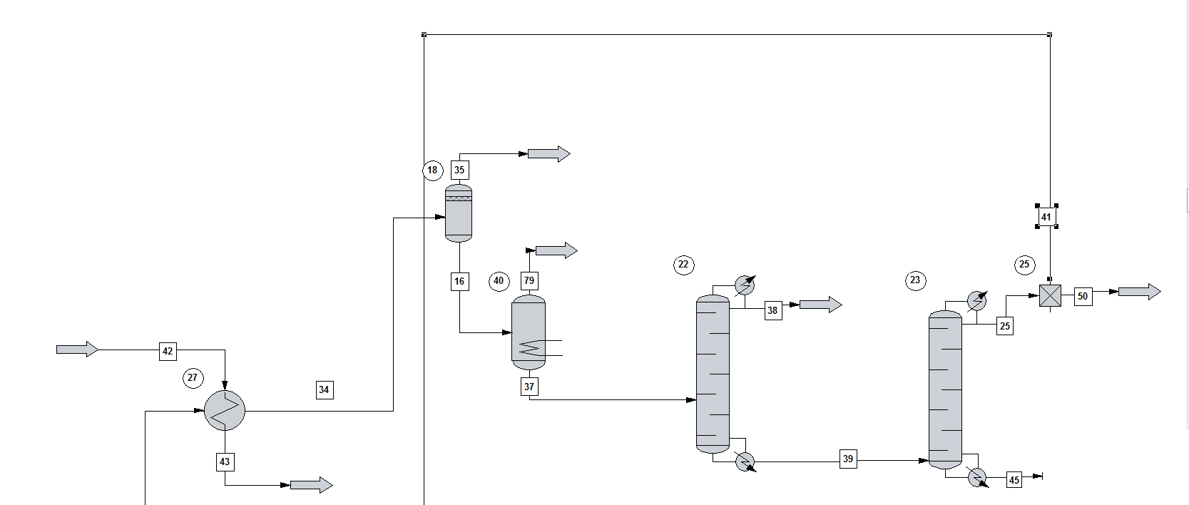
Recycle & Side Product Separation

Slide 25
Recycle & Side Product Separation
Component separator used after flash to remove H₂ & CH₄ as there is virtually none left after flash
ChemCAD attempts to lower temp of stream below 0°C to condense this small amount of H₂ & CH₄ causing convergence problems and greatly skewing duties

Slide 26
Optimization
Sensitivity studies ran on equipment comparing variables usually to amount of a component in product stream
Amount of desired product out of reactor
How much of component left after separation
Values chosen to get best conversion or separation before there was greatly diminished returns
Notes:
Value chosen that would cost less when plot started to level off.

Slide 27
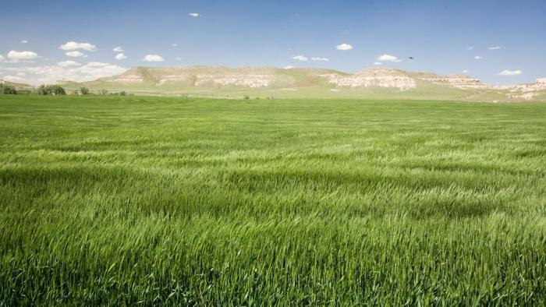
Economic Analysis: Capital Costs
Equipment Sizing + CAPCOST
2015 CEPCI of 537
Grass Roots
15 % for contingency costs
3 % for fees
Land cost of $450,000
Location: North American Midwest
Grassland biome†
† What is a grassland biome? Web. (accessed May 8, 2016). ask.com

Slide 28
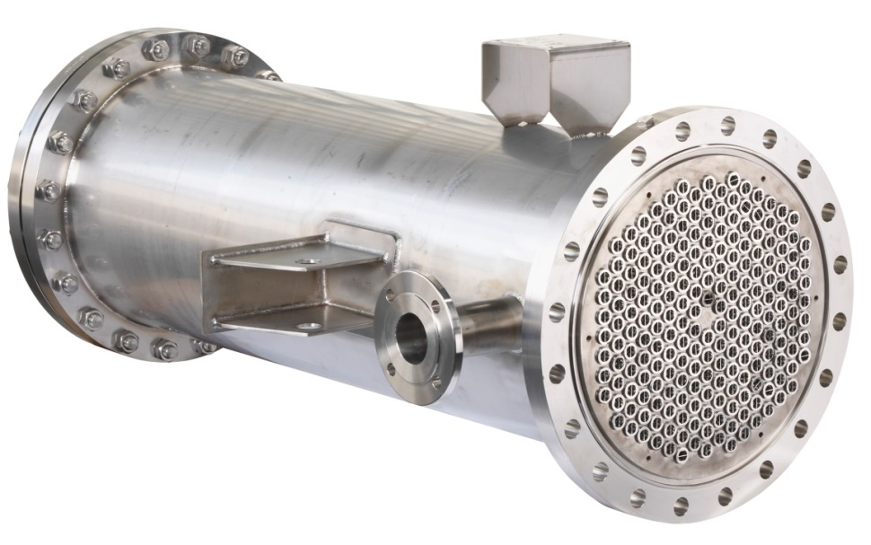
Equipment Sizing: Heat Exchanger
Shell and tube heat exchanger
Parameters required to be sized:
Area of heat exchanger
http://www.indothermindustries.com/product%209.html

Slide 29
Equipment Sizing: Flash Tank
Parameters required for sizing:
Density of vapor stream
Density of liquid stream
Mass flow rate of vapor stream
Mass flow rate of liquid stream

Slide 30
Equipment Sizing: Decanter
Parameters required for sizing:
Density of heavy phase stream
Density of light phase stream
Volumetric flow rate of heavy phase stream
Kinetic viscosity of mixed stream

Slide 31
Equipment Sizing: Distillation Column
Parameters required for sizing:
Density of heavy phase stream
Density of light phase stream
Mass flow rate of vapor stream
Mass flow rate of liquid stream
Kinetic viscosity of entering stream
Number of trays

Slide 32
Equipment Sizing: Reactors
R-101: multi-tubular packed bed reactor
Similar to a shell and tube heat exchanger but has catalyst
Heat duty of the reactor (6169 MJ/hr) → minimum heat exchanging area
Heat exchanging area
Assumption: heat transfer coefficient: 300W/m²K; heating agent: in at 360 °C, out at 330 °C
Estimate number of tubes for given radius and length
Determine number of tubes for optimized reactor volume then determine surface area of those tubes
R-102: reactive distillation reactor
Sized like distillation column with additional cost of catalyst

Slide 33
Equipment Sizing: Reactor 103
Fixed Bed Column
Mass of catalyst using → Volume of catalyst
Assume cylindrical shaped reactor
Total pressure drop of the reactor is limited to 10% of inlet pressure
Pressure drop per length calculated (Ergun Equation)
Pressure drop → Length of the reactor
Length of the reactor & Radius → volume of the reactor
Compare volume of the reactor to volume of the catalyst

Slide 34
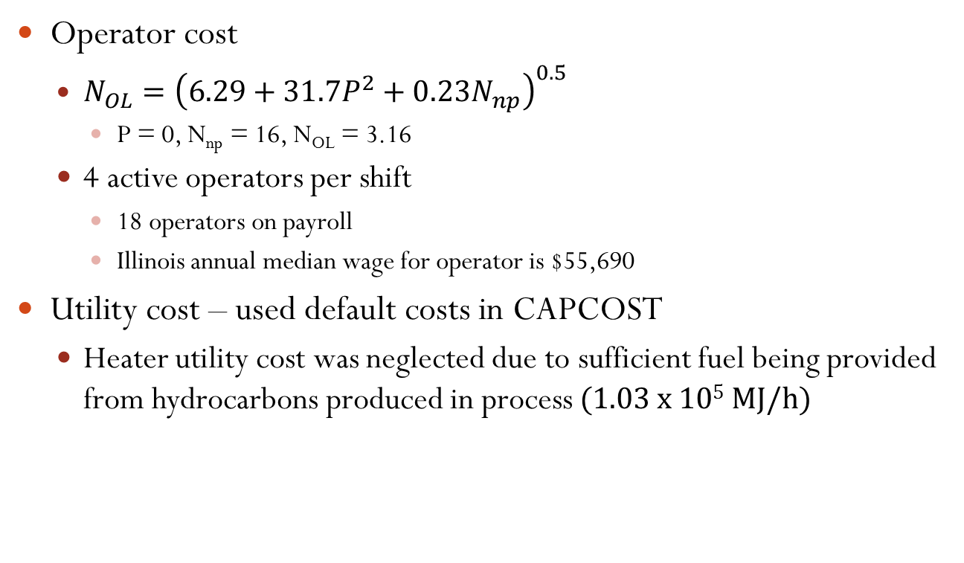
Economic Analysis: Cost of Manufacturing
Operator cost
$N_{OL}={\left(6.29+31.7P^{2}+0.23N_{np}\right)}^{0.5}$
P = 0, N_{np} = 16, N_{OL} = 3.16
4 active operators per shift
18 operators on payroll
Illinois annual median wage for operator is $55,690
Utility cost – used default costs in CAPCOST
Heater utility cost was neglected due to sufficient fuel being provided from hydrocarbons produced in process (1.03 x 10⁵ MJ/h)

Slide 35
Economic Analysis: Cost of Manufacturing
Chemical Pricing from ICIS, GEVO, etc
Catalyst prices used were laboratory prices
Chemical | 2006 Price ($/kg) | Projected 2016 Price ($/kg) | Source
Isobutanol | - | 1.15-$1.48 | GEVO
Terepthalic Acid | 0.925 | 1.066 | ICIS
P-xylene | 1.43 | 1.53 | ICIS
Ni-Al₂O₃ (1% by mass Ni loading) | - | 4272 | RiogenInc
γ-alumina | - | 15.60 | AdvancedMaterials
Platinum on Carbon | - | 9890 | RiogenInc
Isobutylene | 0.70 | 0.752 | ICIS
Di-isobutylene | - | 1.25 | Zauba

Slide 36
Economic Analysis:Profitability
Additional Assumptions:
10 % discount rate
18% hurdle rate
7 year MACRS depreciation
8500 hours of operation a year
15 year project lifetime (not including construction)
No salvage
Assume half of catalyst replaced each year
Two scenarios evaluated: selling PX or TPA as a product

Slide 37
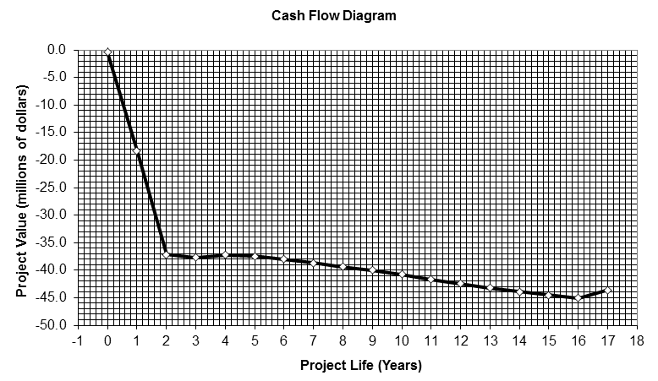
Economic Analysis: Profitability
Selling PX as Product
NPV of -$52.3 million
Undefined payback period
Increase at end is CAPCOST factoring in cost of land and capital costs

Slide 38
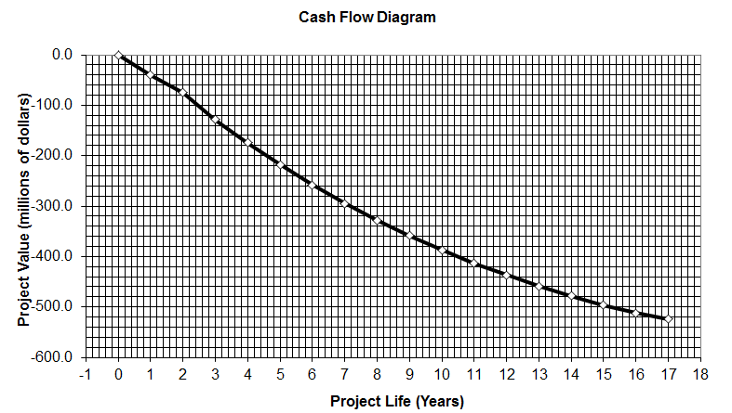
Economic Analysis: Profitability
Selling TPA as product
Used Capital cost and COM without PX from Team 5 ($61.7 and $89 million respectively)
Scaled their costs to the ratio of their PX feed rate and our PX production rate (FCI and COM adjusted to $40 and $58.3 million respectively
NPV of -$524.3 million
Undefined payback period

Slide 39
Profit Conditions
As is, process not generating profit
Two scenarios investigated, increase in price of p-xylene and the decrease in price of impure isobutanol used
Prices were changed until the projected value on the cash flow diagram evened out to 0 at end of 17 years
Above $1.77 per kg of p-xylene (was $1.53)
Below $0.37 per kg of isobutanol (was $0.44)
Notes:
Add cash flow diagrams

Slide 40
Environmental, Health, and Safety Concerns
All reagents are flammable
Need to be stored in appropriate, cool, well-ventilated area
Chemicals not corrosive
Some chemicals (e.g. p-xylene) are hazardous to aquatic environment
Waste water must be disposed of appropriately
Required compliance with federal, state, and local environmental regulations

Slide 41
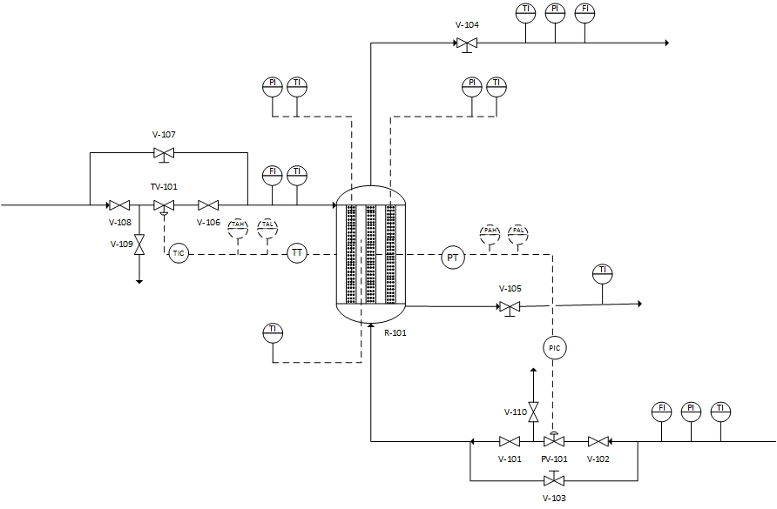
Piping and Instrumental Diagram R-101
9Bar 325C 26839kg/h
0.12% isobutanol 76.9% water 21.8% 2-Methylpropene 1.15% trans-2-butene
Double Block & Bleed Valve
RV-101
Thermal oil
Thermal oil
R – Reactor
P – Pressure
T – Temperature
V – Valve
F – Flow
9Bar 325C 26839kg/h
30% isobutanol
70% water
Double Block & Bleed Valve

Slide 42
Sustainability
Environmentally friendly as raw material generated from bio sources, greatly reduces impact of TPA process
Image better received by public as being green seen as responsible and is becoming more popular
Prepared for petroleum raw material running out or politically difficult to obtain
Becomes profitable as technology to reduce raw material price develops or as current price of oil increases
Differentiates commodity product by being green

Slide 43
Concluding Remarks***

Slide 44
Supplementary Slides

Slide 45
CAPCOST Default Utility Pricing
 | Cost ($/GJ)
Common Utilities
Electricity (110V - 440V) | 16.8
Cooling Water (30°C to 45°C) | 0.354
Refrigerated Water (15°C to 25°C) | 4.43
Steam from Boilers
Low Pressure (5 barg, 160°C) | 13.28
Medium Pressure (10 barg, 184°C) | 14.19
High Pressure (45 barg, 260°C) | 17.7
Fuels
Fuel Oil (no. 2) | 14.2
Natural Gas | 11.1
Coal (FOB mine mouth) | 1.72
 | Cost ($/GJ)
Common Utilities
Thermal Systems
Moderately High (up to 330°C) | 12.33
High (up to 400°C) | 13
Very High (up to 600°C) | 13.88
Refrigeration
Moderately Low (5°C) | 4.43
Low (-20°C) | 7.89
Very low (-50°C) | 13.11
 | Cost ($/tonne)
Waste Disposal (solid and liquid)
Non-Hazardous | 36
Hazardous | 200

Slide 46
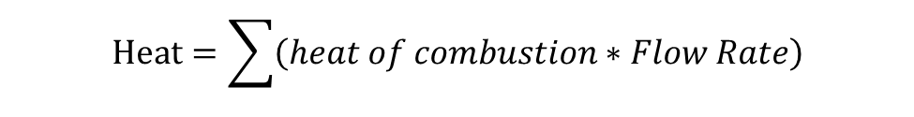
Heat obtained from stream sent to H-101
Chemicals | Heat of Combustion (MJ/kg) | Flow Rate (kg/h)
Isobutanol | 33 | 4.85
P-xylene | 40.8 | 21.7
Toluene | 41 | 4.02
Methane | 50 | 7.35
Propene | 48.9 | 27.2
2-Methyl-1-butene | 47.5 | 4.66
2-Methy-1-pentene | 44.8 | 2.04
1-heptene | 47.4 | 35.2
2-Methyl propene | 48.1 | 535
Trans-2-butene | 45.1 | 149.4
1-Diisobutylene | 44 | 113.4
Hydrogen | 142 | 423.2
2,3-dimethyl-1-hexene | 45 *estimated | 8.28
$$Heat=\sum{\left(heat of combustion∗Flow Rate\right)}$$
Heat≈1.03*105MJ/h

Slide 47
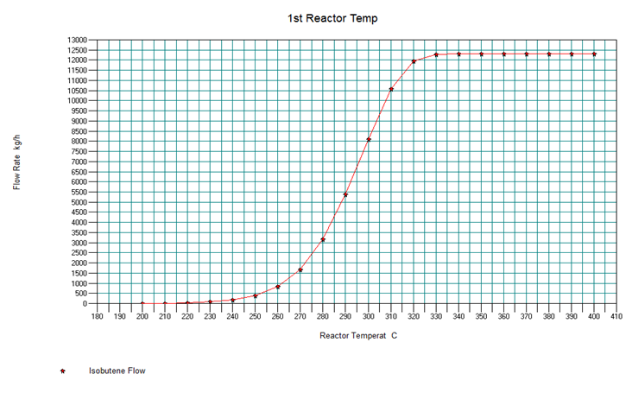
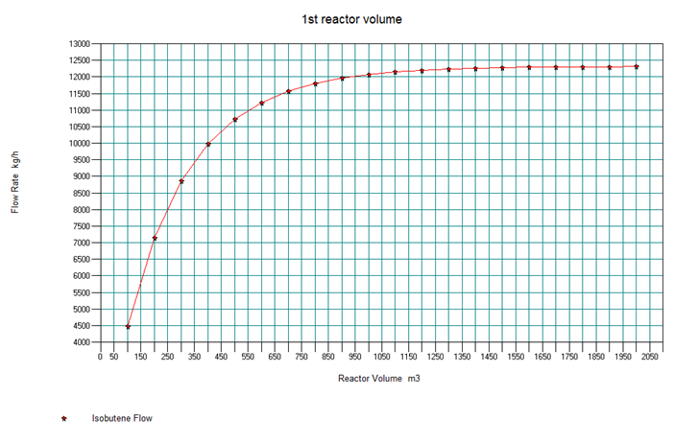
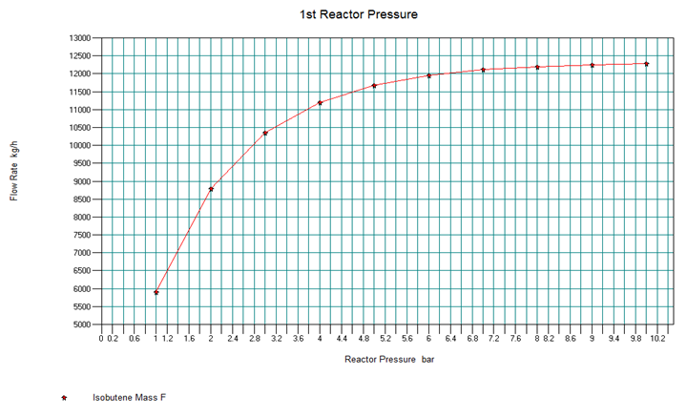
Sample Optimization: R-101 Pressure
First Reactor plots of volume, temperature, and pressure

Slide 48
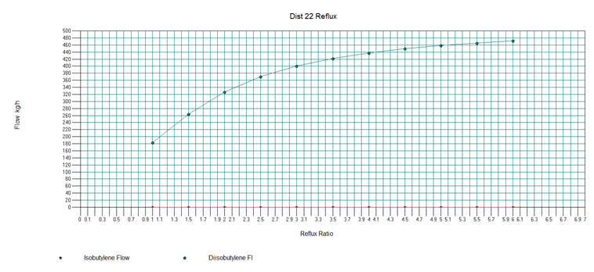
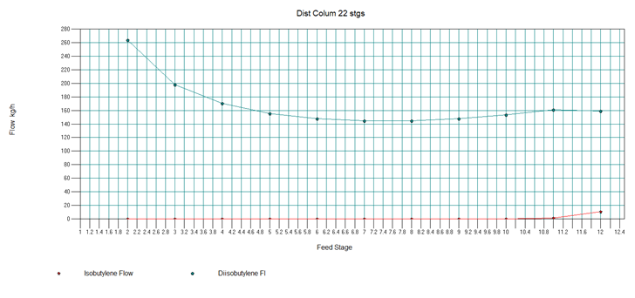
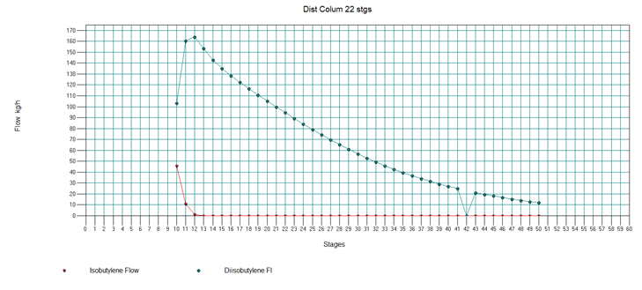
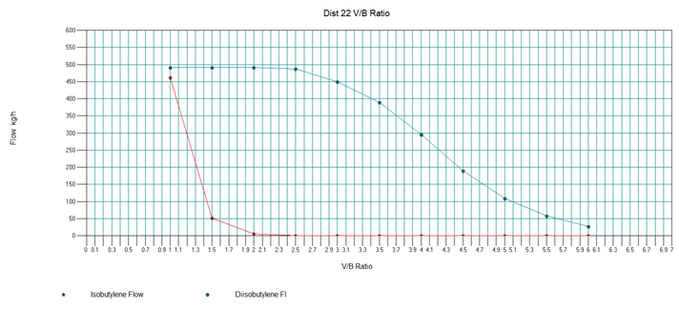
Sample Optimization: T-101 V/B Ratio
First distillation column plots of the number of stages, the feed stage location, the reflux ratio, and the V/B ratio compared to the isobutylene and di-isobutylene in the bottoms

Slide 49
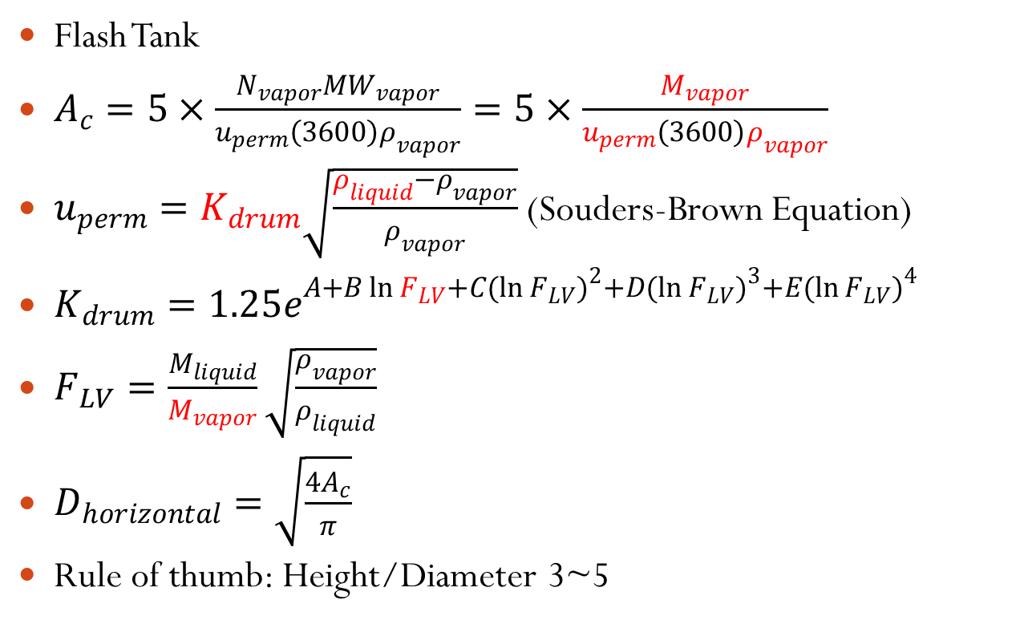
Supplementary: Flash tank sizing
Flash Tank
$A_{c}=5×\frac{N_{vapor}MW_{vapor}}{u_{perm}\left(3600\right)ρ_{vapor}}=5×\frac{M_{vapor}}{u_{perm}\left(3600\right)ρ_{vapor}}$
$u_{perm}=K_{drum}\sqrt{\frac{ρ_{liquid}−ρ_{vapor}}{ρ_{vapor}}}$ (Souders-Brown Equation)
$K_{drum}={1.25e}^{A+B\ln{F_{LV}+C}{(\ln{F_{LV})}}^{2}+D{(\ln{F_{LV})}}^{3}+E{(\ln{F_{LV})}}^{4}}$
$F_{LV}=\frac{M_{liquid}}{M_{vapor}}\sqrt{\frac{ρ_{vapor}}{ρ_{liquid}}}$
$D_{horizontal}=\sqrt{\frac{4A_{c}}{π}}$
Rule of thumb: Height/Diameter 3~5

Slide 50

Supplementary: Decanter Sizing
Decanter
$V_{decanter}=τ_{holding}∗v_{heavy}$
$τ_{holding}=\frac{0.1(hr)}{60 (\frac{hr}{min})} [\frac{μ}{{(ρ}_{H}/ρ_{L})−1}]$
$\text{Rule} \text{of} \text{thumb}\text{: }\text{H}\text{eight}\text{/}\text{D}\text{iameter}\text{ 3.5\sim 5}$

Slide 51

Supplementary: Equipment Sizing
Distillation Column
$D_{c}=\sqrt{\frac{4M_{vapor}}{πρ_{vapor}u_{f}f_{flood}\left(1−\frac{A_{d}}{A}\right)}}$
$u­_{f}=k_{1,adjusted}{\left(\frac{ρ_{liquid}−ρ_{vapor}}{ρ_{vapor}}\right)}^{\frac{1}{2}}$
$k_{1,adjusted}=k_{1}{\left[\frac{σ}{0.02}\right]}^{0.2}$
$k_{1}∝\frac{M_{liquid}}{M_{vapor}}\sqrt{\frac{ρ_{vapor}}{ρ_{liquid}}}$
$h_{distillation}=N_{tray}∗h_{tray}+h_{top}+h_{liquid}+h_{reboiler}+h_{skirt}$
$h_{liquid}=\frac{\frac{M_{liquid}}{ρ_{liquid}}×\frac{holding time}{60min}}{π{\left(\frac{D_{c}}{2}\right)}^{2}}$
Rule of Thumb:
$f_{flood}$ = 0.8
$\frac{A_{d}}{A}$ range from 0.1 to 0.2
Height of vapor engagement: larger than 4 ft
Height of reboiler return: larger than 3 ft
Height of skirt: 15 ft
Liquid holding up time: 5 min

Slide 52
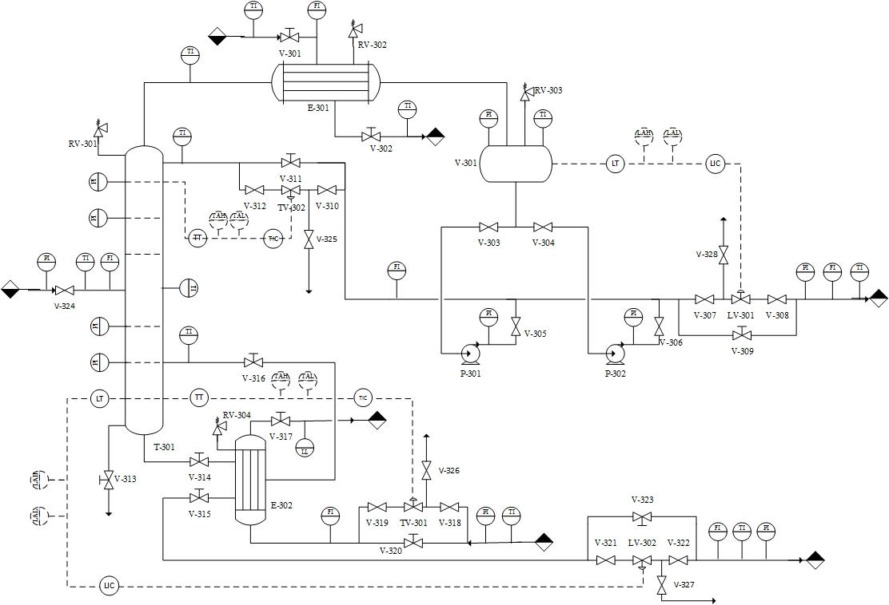
Piping and Instrumental Diagram T-103
2.75Bar 180C 7400kg/h
2.75Bar 180.1C 5680.8kg/h
0.44% O-xylene
99.1% P-xylene
0.44% Triisobutylene
0.29% O-xylene
99.7% P-xylene
2.75Bar 180.7C 1719.1kg/h
0.93% O-xylene
97.14% P-xylene
1.9% Triisobutylene

